Slide 1

Project Proposal:
Natural Language Processing for Classification of Aviation Safety Reporting Systems
Dong-Quan Vu
Céline Berthou
Jean-Frédéric Diebold
Date: 03/11/2023

Slide 2

Chapter 1
Presentation

Slide 3



Presentation
Dong-Quan
Vu
Jean-Frédéric Diebold
Céline
Berthou

Slide 4
Chapter 2
Safran presentation

Slide 5
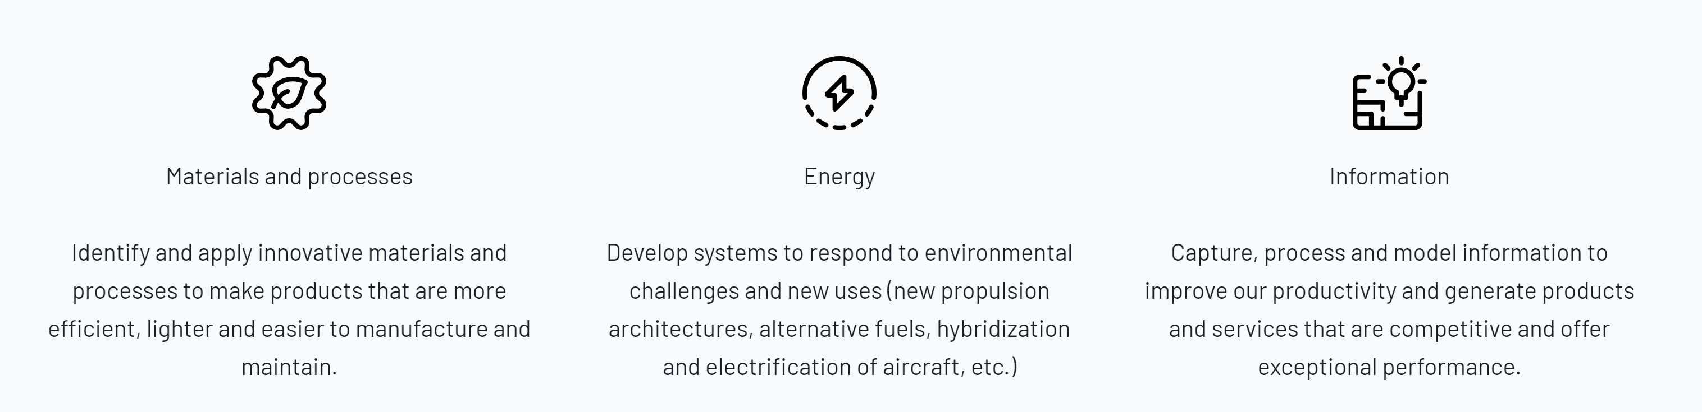
SAFRAN TECH at the core of the digital transformation
Models
Safran Tech contributes to the development of know-how and technologies responding to the technical challenges and challenges of digitalization, in particular through :
AI / ML
Models and simulation,
Sensors technologies,
Signal, Image and data processing.
Simulations
Data

Slide 6

DST (Digital Science & Technologies)
Software engineering and HPC
Software architecture
Software Development
Mathematics and Algorithms
Mathematics and theoretical tools
Algorithms and applied science
Physicals Models and simulation
Mechanic and thermic of solids
Cyber-physics systems
Mechanic and thermic of fluids
Sensors and physical measurement systems
Design, modelling and simulation of cyber-physics systems
Multi-physics systems
Waves/Material Interactions Physics
Design Systems
Scientific computing

Slide 7
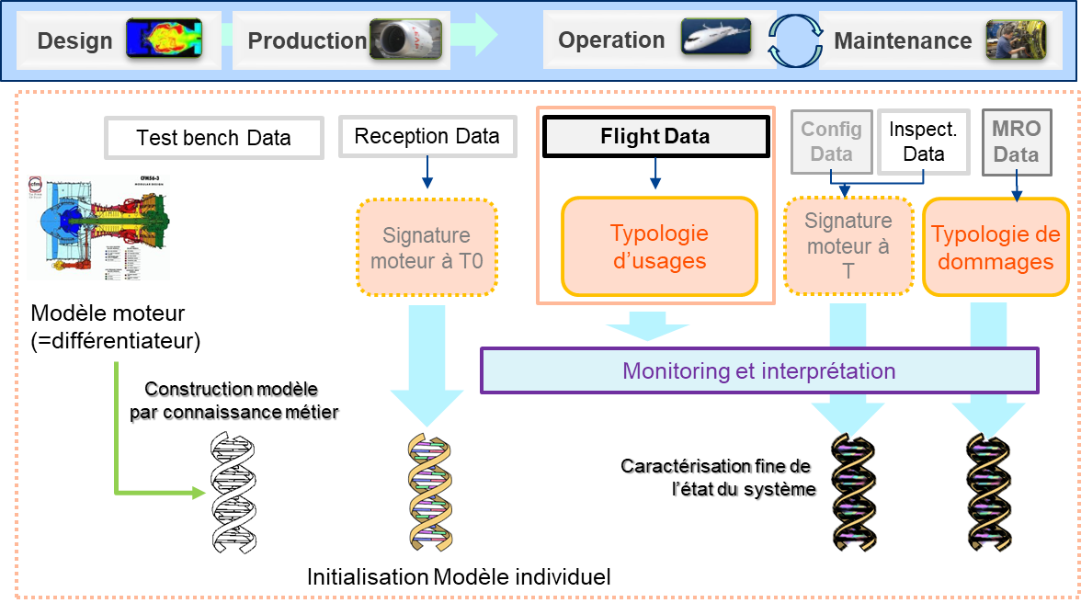
MATD : MATHEMATICS & ALGORITHMS ON TEMPORAL DATA
Combining our knowledge as product designers with the operation data to create value
Why DOES IT Matter to SAfran?
Our business model evolved towards a service model (hours renting) and maintenance cost optimization became strategic
Better understanding how our products evolve in time is key to build differentiators
Our long term future depends on our capacity to design products optimized for its effective usage
Applications
Continuous flight data and vibration data based advanced Health Monitoring indicators construction.
Enriched features based ART analysis (Anomaly, Rupture, Trend).
Physics-Informed Machine Learning model : engineering knowledge compliant human interpretable product signatures.
Improved remaining (product) life time prediction.
COMPETENCIES
Expertise in data analysis (evaluate its potentiel)
Expertise in machine learning (optimize its potential and build a data driven model)
Operational/design knowledge integration to build a new hybrid model (algorithm design)
Relevant problem formulation with constructive methodology
Machine learning combined signal processing
Modelling & maintenance strategy simulation

Slide 8
Chapter 3
Project Context & Objectives

Slide 9
Context
Large amount of textual data, such as maintenances reports, tests reports, events reports, etc.
Need to use NLP models to automatically process all the available textual data
Safran datasets are confidential.
Access to the public ASRS (Aviation Safety Reporting System) database from NASA. There are some differences between ASRS and Safran datasets which are:
Textual data are more unstructured and bad written in Safran data
Smaller-sized labelled database (around not more than 3000 labelled data) in Safran data vs. around 100 000 in ASRS
Many labels (around 100 labels) in Safran data vs. 14 labels in ASRS
Relevant projects at Safran:
A project, namely AeroBOT (next slide), on ASRS data with a benchmark of several NLP models.
A project on Safran data with one model: original BERT model fine-tuned with the labelled database

Slide 10
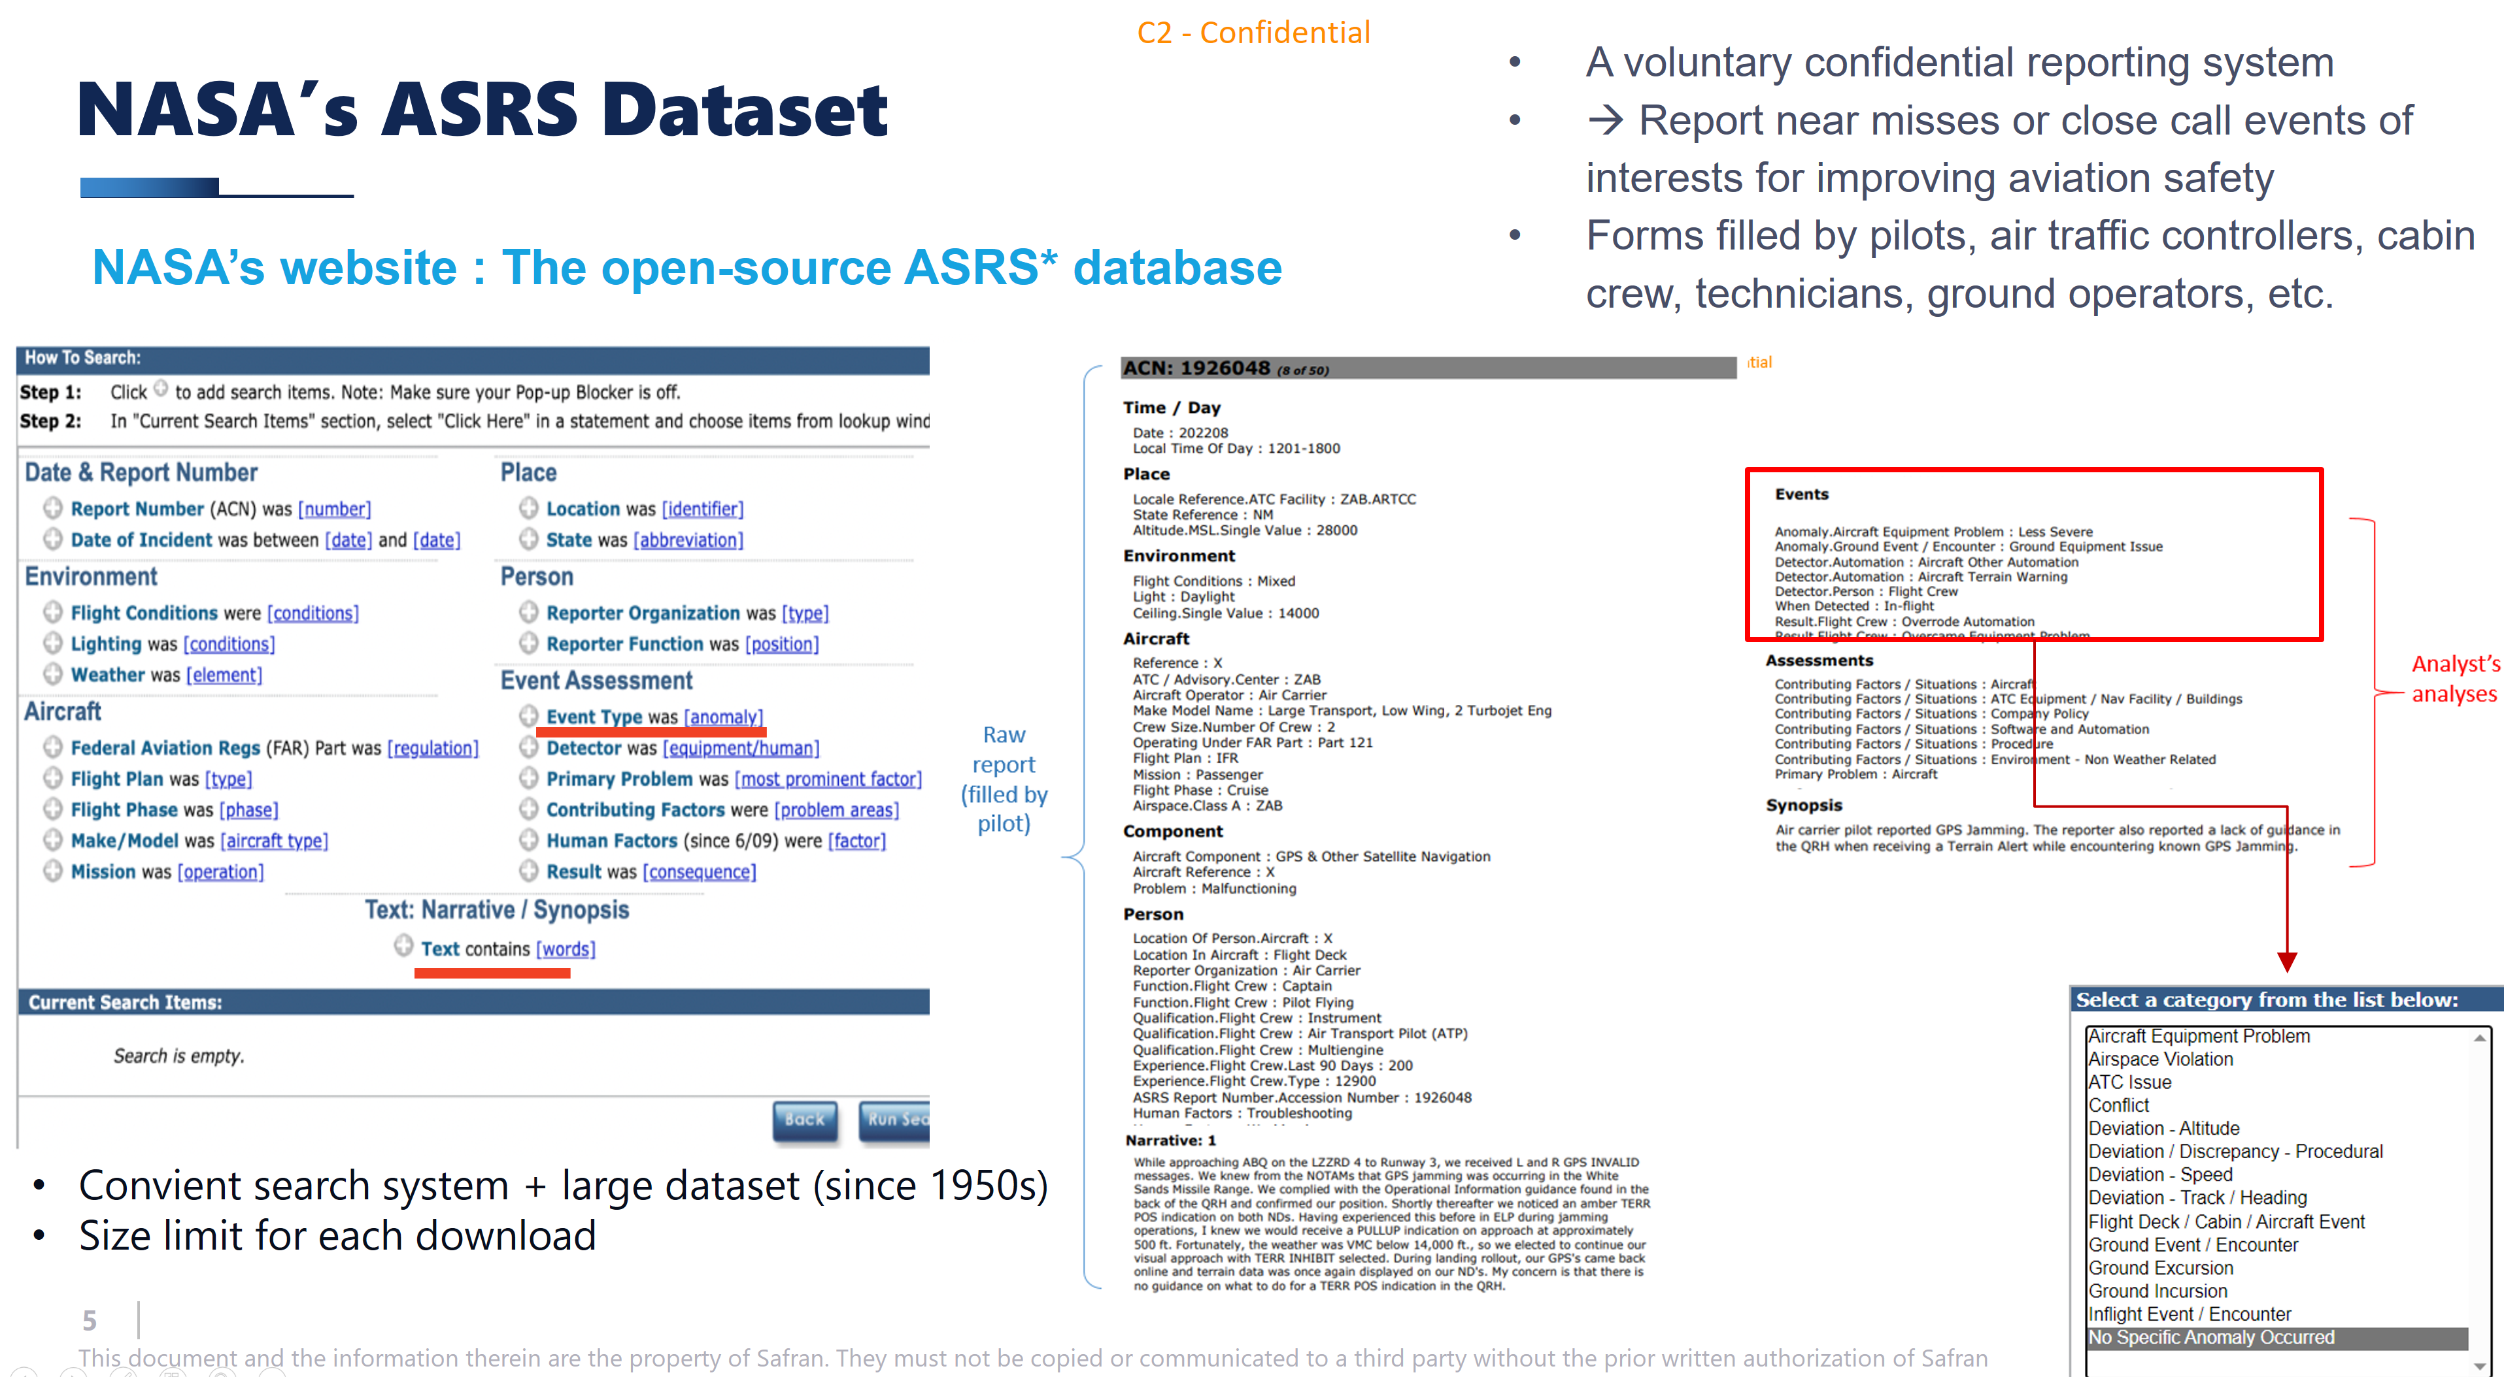

Slide 11
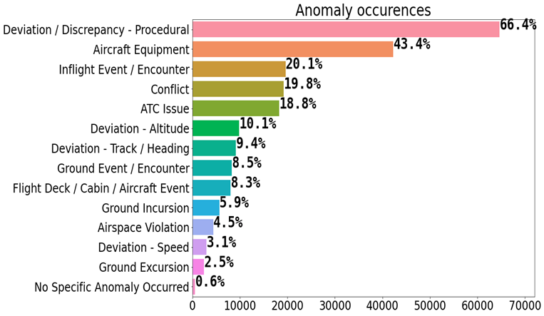
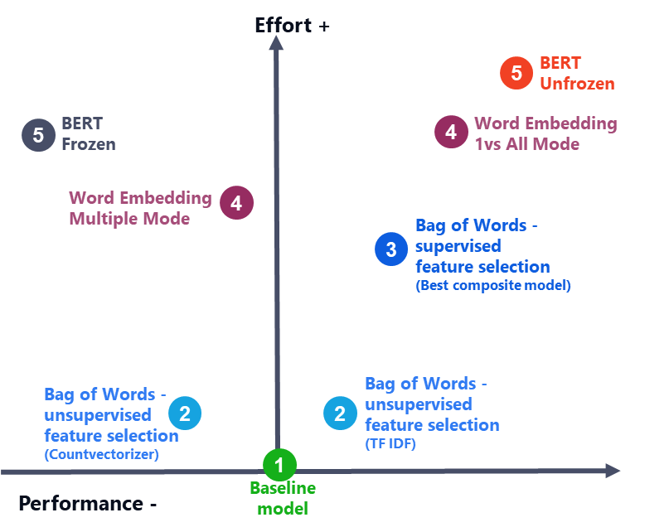
AeroBOT project
Project to classify aeronautic narratives of abnormal events by performing NLP (Natural Language Processing) on narratives containing technical jargon (TLP = Technical Language Processing)
Open-source ASRS database
Difficulties :
Technical jargon
Model multi-labels : the model should be able to predict multiple labels simultaneously.
Highly unbalanced database
Models comparison & the best model is: BERT “unfrozen”, considered then as the reference model for our study

Slide 12
Goals
The objective of the project is the same as AeroBOT project : texts classification by abnormal events but we would like to challenge the BERT unfrozen model !
How?
Compare BERT unfrozen with SafeAeroBERT and other potential models specialized in the aerospace domain
Test by using only narratives as inputs, and by adding to the narratives other information present in other columns
Comparison with LLM (Large Language Model) models
By using the LLM model to do the embedding of the narratives and the labels, and to identify for each narrative the nearest label with a similarity distance (by structuring & not structuring the narratives)
By testing prompt engineering with different LLM models
(Optional) By fine-tuning LLM models
We can test different LLM models available on Hugging Face : LLaMa2, Mistral-7b, Vicuna, Falcon, etc.
Do the same tests on modified data (with constraints of Safran data)

Slide 13
Chapter 4
Collaborative work

Slide 14
Organization
Estimated time spent on the project ? End date of the project ?
Report + presentation ? Dates ?
Weekly meeting : each Friday 14h30 ?

Slide 15
Planning
17/11:
Understanding of ASRS dataset: descriptive analysis of the dataset, first visualizations
We will provide you:
Bibliography on NLP/LLM
Notebooks on use of original BERT
12/01: tests of BERT unfrozen + potential models specialized in the aerospace domain (SafeAeroBERT, etc.), without/with additional information of other columns
02/02:
tests of different LLM models (prompt engineering)
tests of embeddings with LLM models (structured/not structured data)
(optional) tests on data with constraints of Safran data
01/02: writing of the report on the synthesis of the results + Safran validation
22/02: report delivery date?
29/02: presentation date?

Slide 16
First Week (03/11/2023 - 10/11/2023)
Topics | Materials | Tasks | Expectation
Bibliography | Papers on ASRS dataset Basic tutorial on BERT Basic tutorial on LLM Or any other materials | Quick read of papers + tutorials (and beyond) | Basic understanding of concepts. Prepare questions (sent by emails).
Data | Link of dataset | Download dataset Prepare a notebook for basic pre-processing and visualization. | Basic understanding of the dataset Exploring characteristics of input narratives + Creating label vector
Notebook | A Tutorial on Bert (frozen) with multiple-labels on a sampled dataset | Install packages for running the notebook (if possible) Launch Bert frozen on ASRS dataset and check the performance | See the power and limitation of Bert.

